Slide 1

Susceptibility Assessment of different regions related to the Glacier Hazards
CE – 594 GEOHAZARD SCIENCE AND ENGINEERING
Course Instructor
Dr. Rishikesh Bharti (Associate Professor)
Department of civil engineering
Indian institute of technology Guwahati
Assam (India) – 781039
2025
Cecilia L Phanrang - (244104001)
M Harini Krishna - (244104007)
Pritam Roy - (244104009)
Srimaya Mohapatra - (244104010)

Slide 2
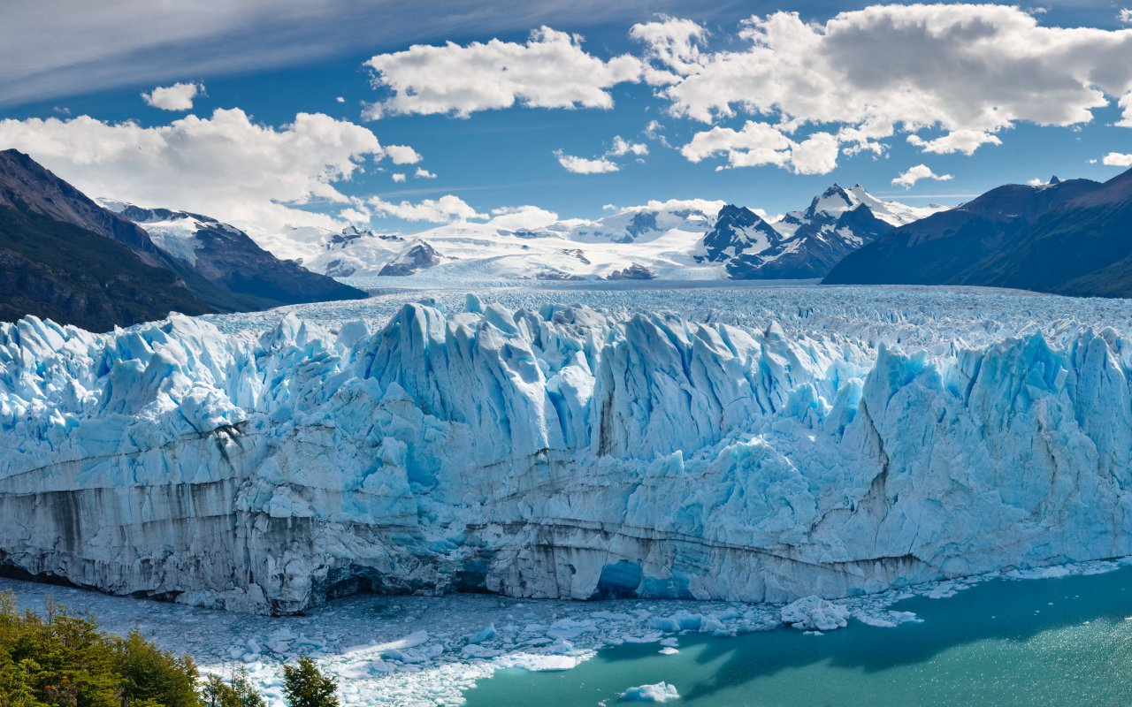



Table of Contents
Introduction
Study Area
Conclusion
Methodology
Results and Discussion
Glacier National park, Argentina

Slide 3
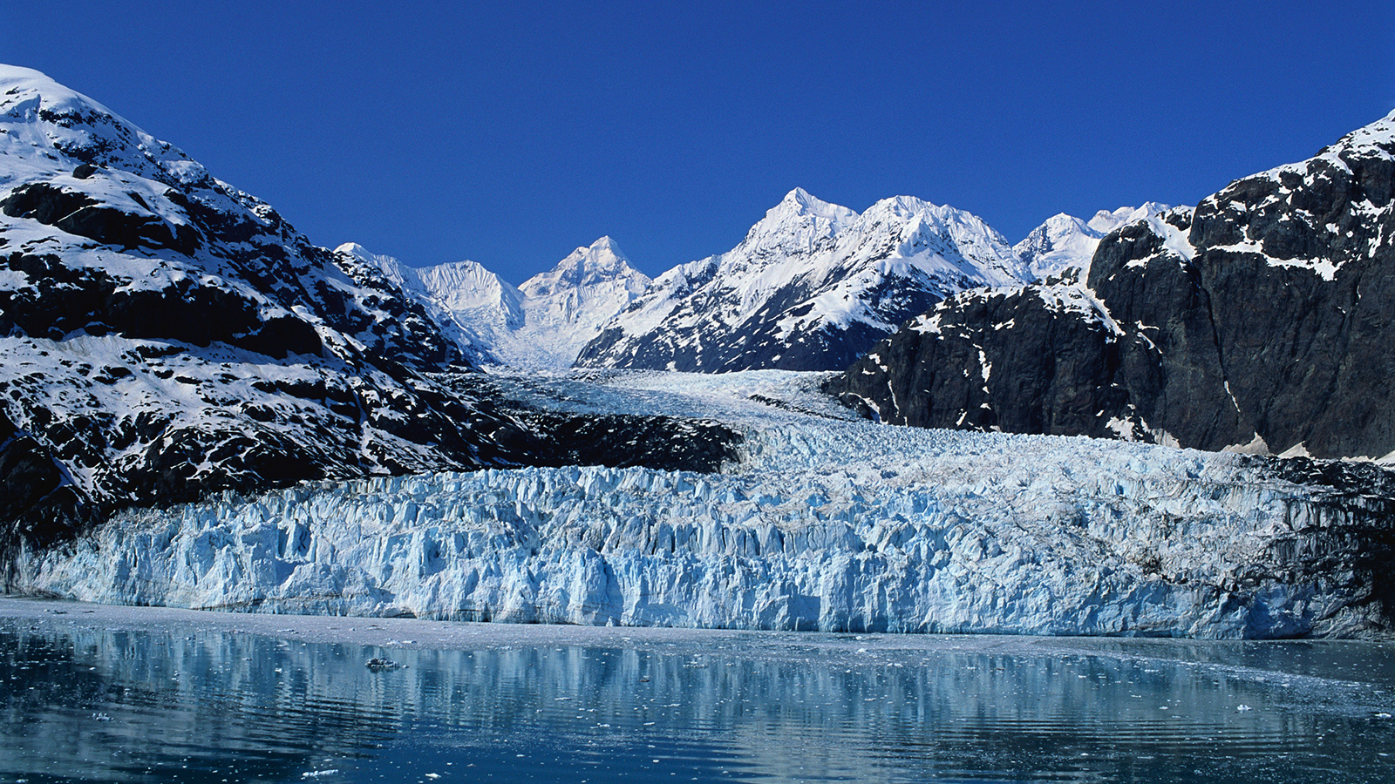
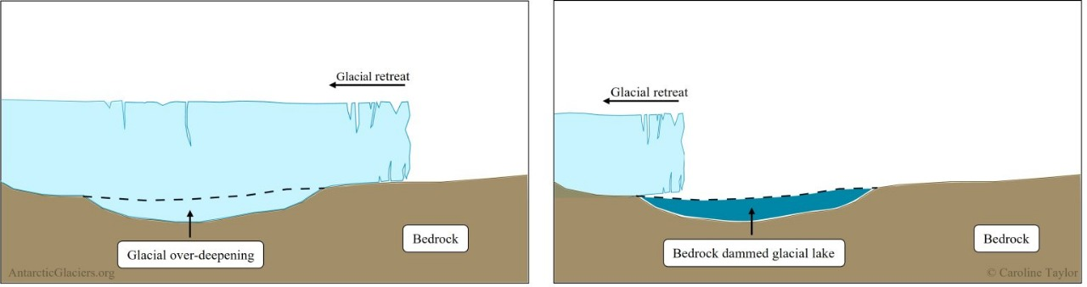
Introduction
Glacier – It is large, long-lasting mass of ice found on the land that moves because of gravity.
Glacier Hazards - They Glacial lake outburst floods (GLOFs), ice avalanches, and glacier surges. These hazards can threaten people, infrastructure, and the environment.
Glacier Lakes - During the last few decades, accelerated ice mass loss and Glacier retreat has resulted not only the expansion of existing glacial lakes but also the formation of new glacial lakes . As a result, glacial lakes are now found across all glaciated regions.
A proglacial lake is a body of water that forms in front of a glacier due to melting ice. These lakes are typically dammed by moraine, ice, or bedrock

Slide 4
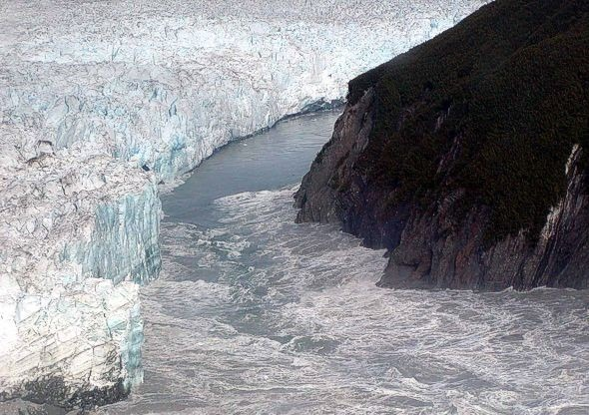
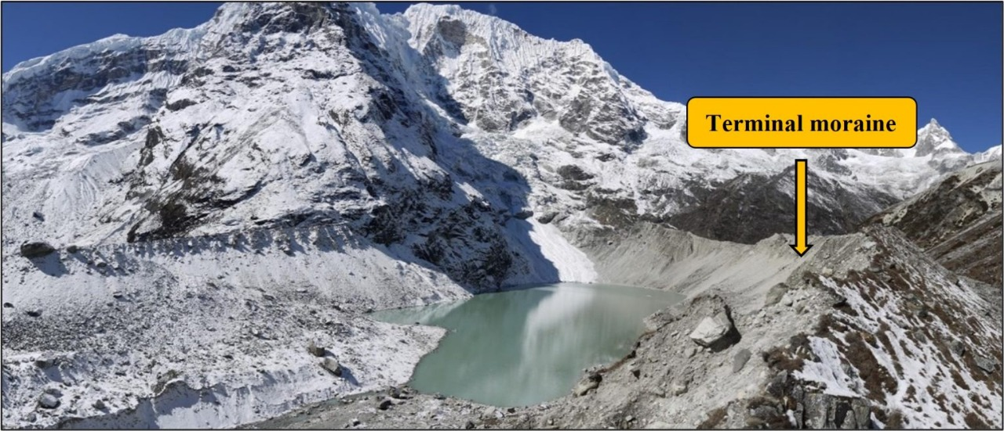
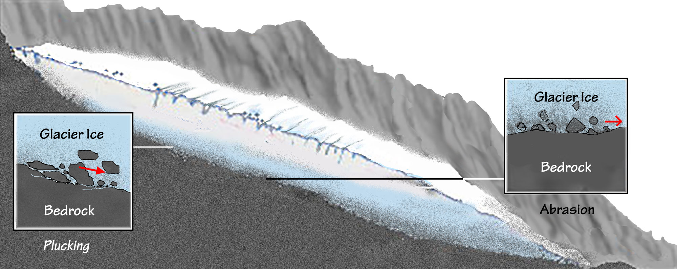
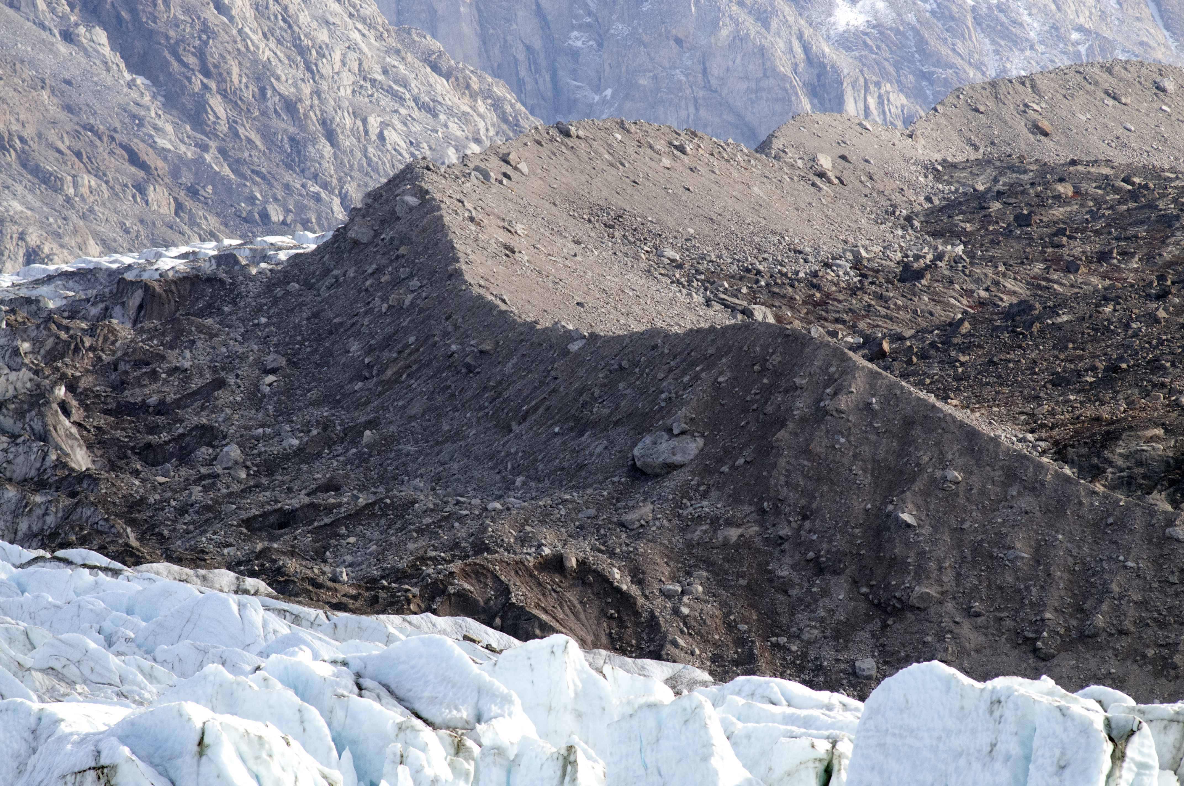
A glacial lake outburst flood (GLOF) is a release of meltwater from a moraine- or ice-dam glacial lake due to dam failure GLOFs often result in catastrophic flooding downstream, with major geomorphic and socioeconomic impacts.
Glacial debris refers to the rock debris that is eroded, plucked up, and entrained in the flowing ice of a glacier as it moves down mountainsides.
GLOF, Hubbard Glacier, Alaska, 2002
Moraines As glaciers advance and retreat, they result in transportation of rock debris, depositing it in ridges known as moraines, which mainly act as natural dams

Slide 5
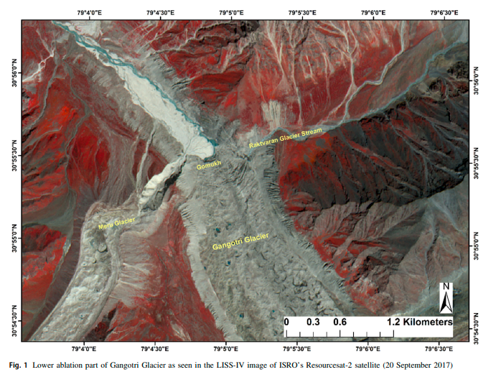
Study Area – 1 (Gangotri Glacier)
Location: Gangotri Glacier, Uttarkashi District, Uttarakhand, India (30°55′26.88″N, 79°40′53.20″E).
Elevation: 4100 – 7000 masl.
Size: Length: 30 km, Width: 0.5 m to 1.75 km, Area: 122 km².
Tributaries: Raktvarn (15.90 km), Chaturangi (22.45 km), Kriti (11.05 km), and 18 minor glaciers.
Fig 1: Lower ablation part of Gangotri Glacier as seen in the LISS IV image of ISRO’s Resourcesat -2 satelite (20 September 2017)
Source: Thakur, P,K., Pandey & Chauhan, P (2023), Assessment of dynamics frontal of part of Gangotri glacier, India, from 2017 to 2021 using remote sensing data, Journal of Indian society of Remote Sensing, 51(4), 691-698.

Slide 6
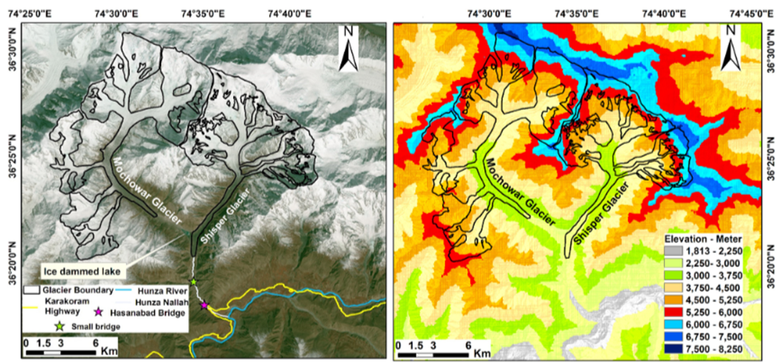
Study Area – 2 (Shisper and Mochowar glaciers)
Shisper and Mochowar glaciers are part of Hassanabad glacier system.
Located in Western Karakoram ranges (36.35-36.48⁰N, 74.57-74.61⁰E).
Watershed area drained by both glaciers 359km².
The melt water flows to Hunza river.
The region has an annual temperature of 11°C and precipitation of 125mm.
Fig 2: Topography of Shisper and Mochowar glacier system.
Source: Singh H et. Al (2023)

Slide 7
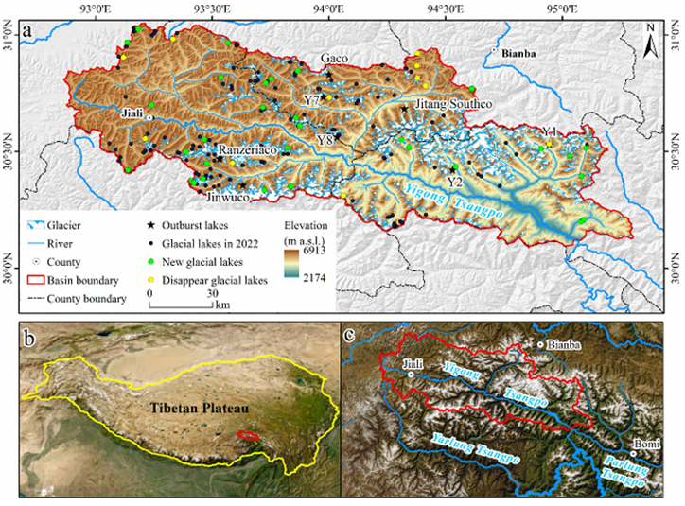
Study Area – 3 (Yigong Tsangpo Basin)
Yigong Tsangpo basin is consist of parts of three counties which are Jiali, Bainba, and Bomi.
It is located in the southeastern Tibetan plateau (Fig.3).
The basin area is 13,533 km² and extended up to 286 km).
Fig 3: Overview map of study area (a) distribution of glacial lakes; (b) location of the study area; and (c) surrounding water systems (base map from World Imagery),
Source: Ziyang et al. 2024

Slide 8
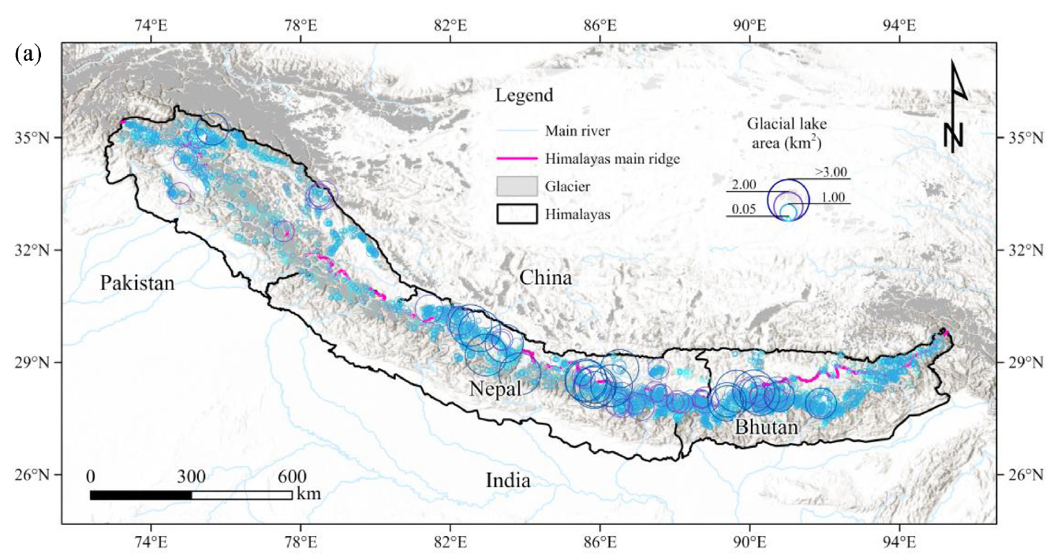
Study Area – 4 (Qinghai – Tibet Plateau)
Latitude - 26.35° ‒ 35.85 ° N, Longitude - 72.77 ° ‒ 95.43 ° E
Lies in the Southern margin of Himalayas has various tectonic fault zones in the region from south to north.
Area – 662,200 km².
Himalayas - 20,436 glaciers (~19,900 km²) in 2015.
Study Area - 8,024 glacial lakes (~635 km²) in 2015.
This area experiences high precipitation, has steep terrain, loose moraine deposits, abundant glaciers and glacial lakes.
Leads to the GLODF’s
Fig 4: Topography of study area in Himalayan region on the southern margin of the Qinghai-Tibet Plateau
Source: ZHOU B. et al. / Advances in Climate Change Research 15 (2024) 500e514

Slide 9
Methodology 1 - Thakur K.P et. al
Data Collection
1)Multi-sensor remote sensing data acquisition:
2)Sentinel-2 MSI (Medium Resolution)
3)Landsat-8 OLI (High Resolution)
4)IRS LISS-IV (Very High Resolution)
Data Preprocessing
1)Image distortion correction
2) Image enhancement and alignment
3) GIS-based processing
Snout Position Monitoring
1)Manual mapping through visual interpretation
2)Use of FCC (False Color Composite) satellite images.
Surface Velocity Measurement
1)Feature tracking using Sentinel-2 MSI images
2)Application of COSI-CORR (Co-Registration of Optically Sensed Images and Correlation) for phase-based correlation

Slide 10

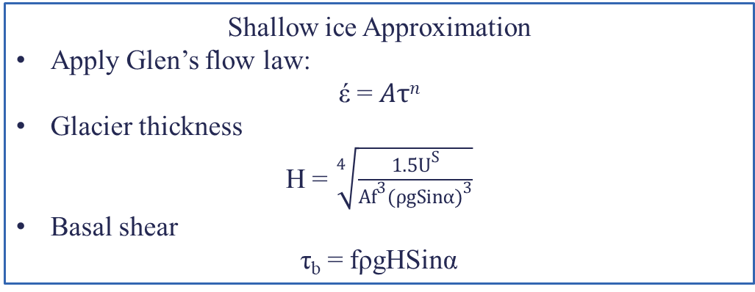
Methodology 2 - Singh H. et al.
Glacier surface velocity
Sentinel-2 image (2016 -2022)
GIV Tool.
Enhancement and correction of satellite images
Divide image into small windows.
Compare displacement between 2 images.
DEM
Glacier surface velocity
Glacier boundary or flow line (RGI)
HIGHTEM tool
Shallow ice Approximation
Apply Glen’s flow law:
έ = $Aτn$
Glacier thickness
H = $\sqrt[4]{\frac{1.5U^{S}}{Af^{3}{(ρgSinα)}^{3}}}$
Basal shear
τ_{b} = fρgHSinα
Glacier ice thickness and overdeepening site identification

Slide 11
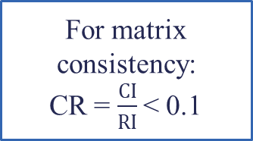
Methodology 2 - Singh H. et al.
Estimation of ice dammed and future lake volume
NDWI of Sentinel-2 image (2016 -2022)
V= 0.104A_{L}^{1.42}
Flood modelling
DEM
River cross section
HEC-RAS tool
Planet lab imagery
2D – hydrodynamic modelling simulation -22nd/May/2022
Validation of post event morphological changes of stream.
Glacial lake outburst flood susceptibility
10 critical factors selection based on previous GLOFs.
AHP
W_{s} = ∑C_{i}× W_{i}
For matrix consistency:
CR = $\frac{CI}{RI}$< 0.1

Slide 12
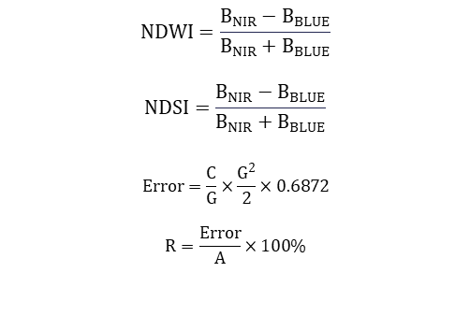
Methodology 3 - Ziyang et al.
Landsat and ALOS DEM data
Data collection from 1990 to 2022
24 images from different area
Automated extraction
By NDWI and NDSI identified the boundaries of Glacier lakes
Determine suitable threshold to binarize the images
Preliminary verification
Remove all the polygons and correct glacier position
Verify the results in ArcGIS by visual inspection
Image preprocessing
Radiometric calibration
Atmospheric correction
Image fusion
Mosaicking and
Clipping.
Ratio image calculation in NDVI
Convert binarized raster data into vector files and imported into ArcGIS
Final verification and modification
Calculating area error
Glacial lake inventory
Used world imagery and Google earth
Creating 10km buffer zone between parent glacier to lake
Image resolution and geometric correction
Calculation of area error
Data collection and MDL identification:
$$NDWI=\frac{B_{NIR}−B_{BLUE}}{B_{NIR}+B_{BLUE}}$$
$$NDSI=\frac{B_{NIR}−B_{BLUE}}{B_{NIR}+B_{BLUE}}$$
$$Error=\frac{C}{G}×\frac{G^{2}}{2}×0.6872$$
$$R=\frac{Error}{A}×100\%$$
Formulas used:

Slide 13
Methodology 3 - Ziyang et al.
Glacial lake inventory
104 MDLs are considered
Training set
70 MDLs
Validation set
30 MDLs
Select the impact factors
After Wald tests we considered 6 most significant factors
Outburst susceptibility assessment model
P(Y=1)=$\{1+exp⁡[−(−12.424+4.88X_{1}+3.17X_{2}+0.109X_{3}+0.196X_{4}+0.141X_{5}−3.294X_{6})]\}^{−1}$
Outburst susceptibility assessment model
P(Y=1)= {1+exp⁡[−(−12.424+4.88𝑋_1+3.17𝑋_2+0.109𝑋_3+0.196𝑋_4+0.141𝑋_5−3.294𝑋_6)]}^(−1)
Binary logistic regression
P(Y=1)=$\{1+exp⁡[−(α+β_{1}X_{1}+β_{2}X_{2}+⋯+β_{n}X_{n})]\}^{−1}$
Binary logistic regression
P(Y=1)= {1+exp⁡[−(𝛼+𝛽_1 𝑋_1+𝛽_2 𝑋_2+⋯+𝛽_𝑛 𝑋_𝑛)]}^(−1)
Verify the feasibility of the model
Plotted the ROC curve
Six factors are:
MDL area expansion rate
Glacier slope
Parent glacier area
Backwater slope of the moraine dam
Avg. glacier tongue slope
Lake to parent glacier distance

Slide 14
Methodology 4 - ZHOU B. et al.
Data Sources
Machine Learning Model Training
Model Evaluation & Selection
Susceptibility Mapping & Analysis
Data Sources:
Glacial Lake Data (Satellite Imagery, GIS)
Topographic Data (DEM – 30m resolution)
Climate Data (Temperature, Precipitation)
Hydrology Data (Watershed Area, Connectivity Index)
Preprocessing: ✔ Catchment-Based Mapping (1,435 catchments analysed)
Area of 1.07 to 360.30 km2.
Algorithms Used:
Support Vector Classification (SVC)
Random Forest (RF)
Gradient Tree Boosting (GTB)
Optimization Method: Whale Optimization Algorithm (WOA) – fine-tunes ML parameters for better accuracy
Model Training: ✔ 70% Training Data | 30% Test Data ✔ Cross-validation applied to prevent overfitting
GLODF Risk Zones Identified:
High & Very High Risk (Mostly in Eastern & Central Himalayas)
China-Nepal Border Identified as a Hotspot
128 Transboundary Threat Catchments (CPTT) Identified
Key Contributing Factors: (23 VH & 29 H) ✔ Topographic Potential (39.96%) – Most critical factor ✔ Potential Flood Volume & Glacial Lake Volume – Key triggers for GLODFs
Performance Metrics:
ROC-AUC Score (Model Classification Ability)
Accuracy (ACC) (Correct Predictions %)
MSE & RMSE (Error Measurement)
Best Model Identified: WOA-SVC – Achieved highest prediction accuracy

Slide 15
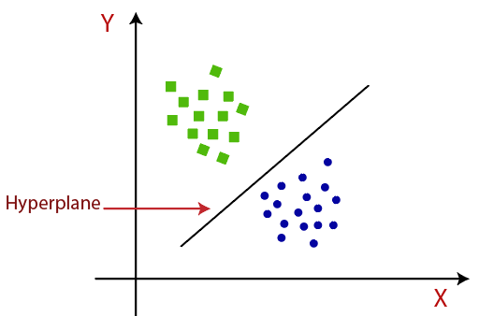
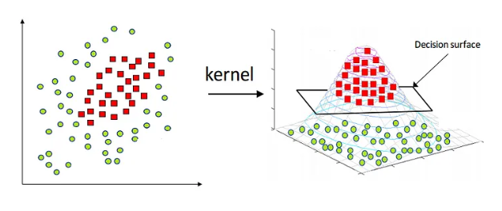
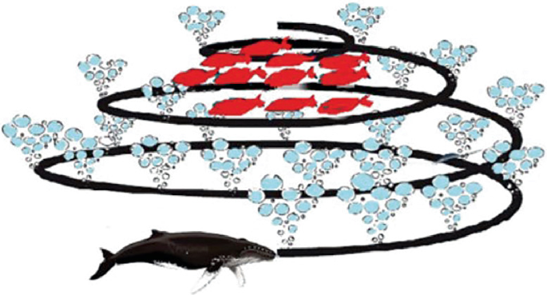
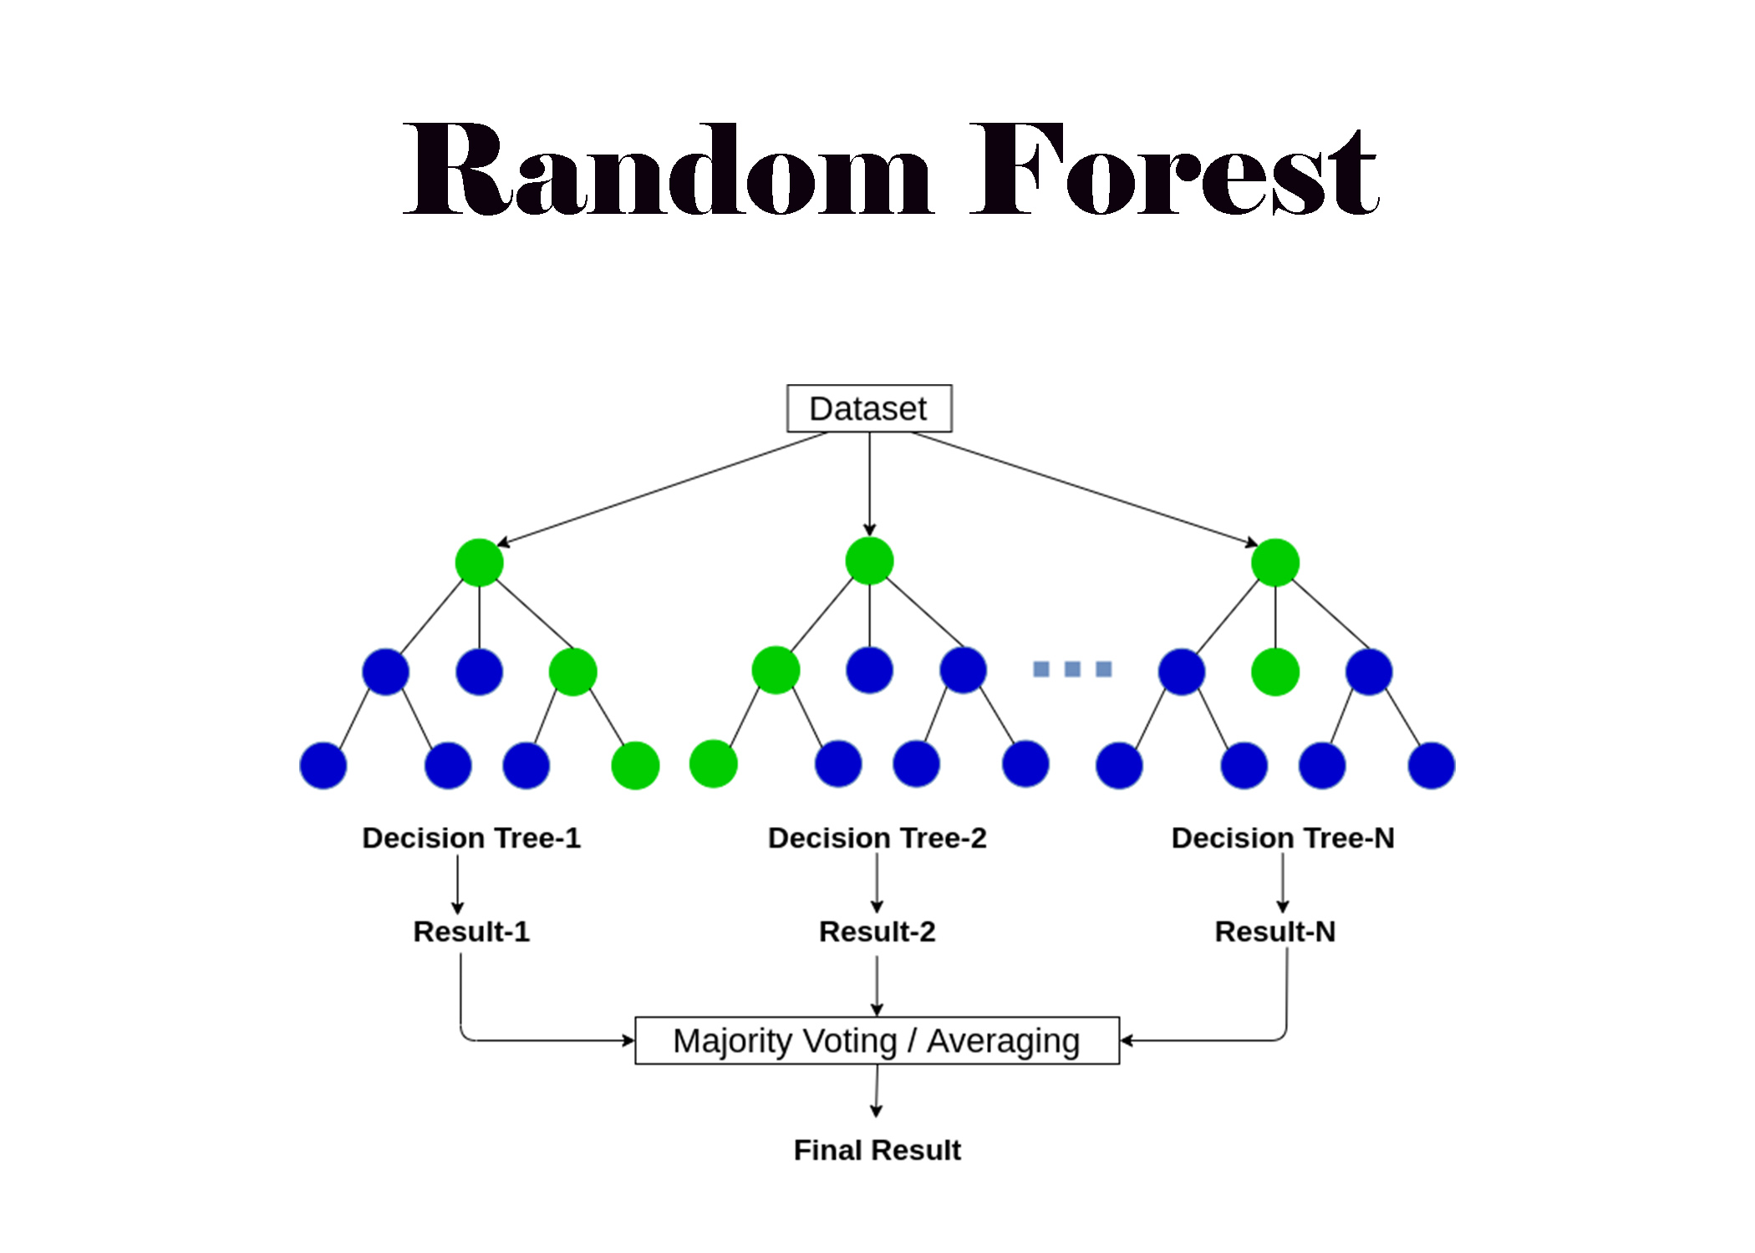
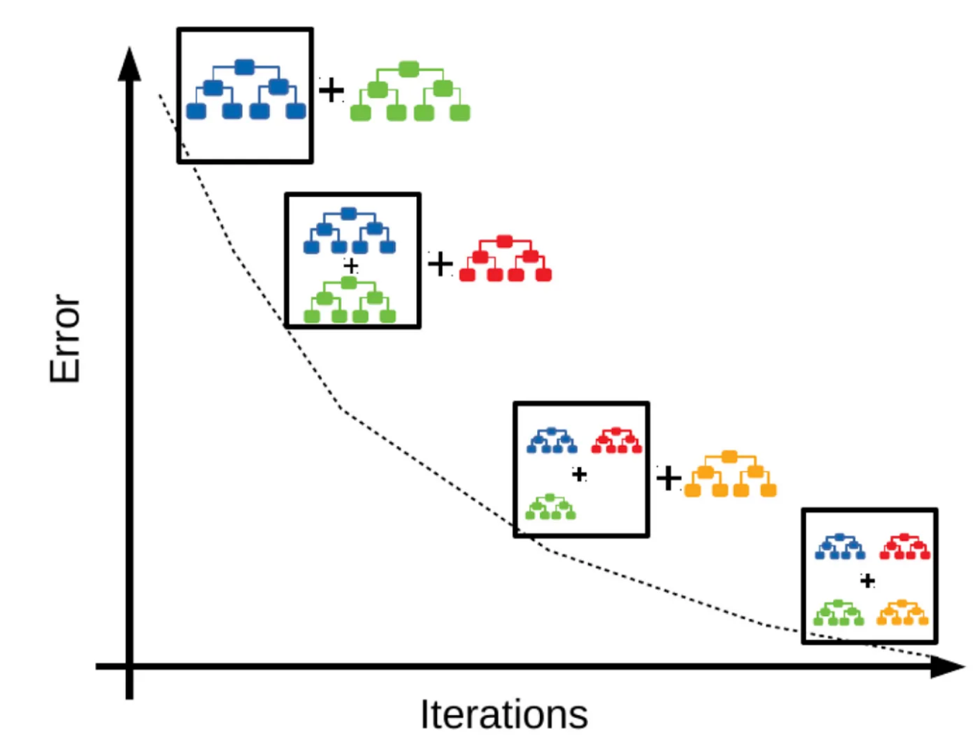
Support Vector Machine (SVM)
Fig 5: Linear vs Non linear (kernel) in SVC
Fig 6: Humpback whale searching the prey with the bubble net in WOA
Gradient Tree Boosting (GTB)
Fig 7: Random forest Representation Diagram
Fig 8: Graph representing the errors & iterations of GTB

Slide 16
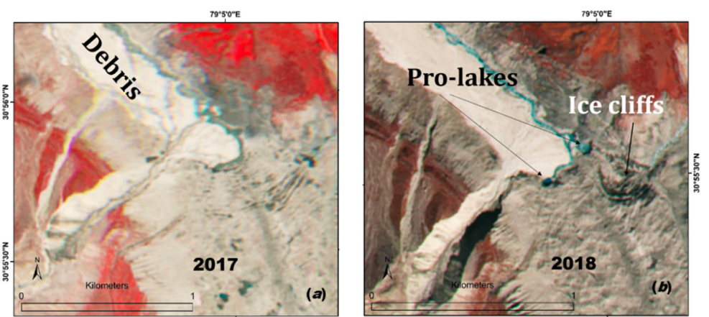
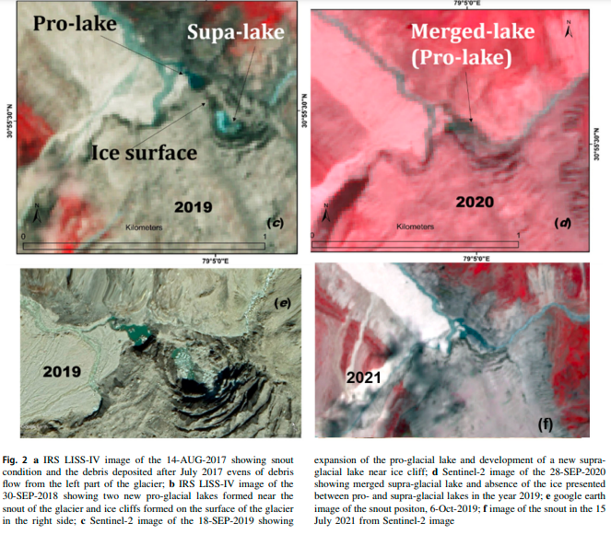
Results 1 - Thakur K.P et. al
2017
.
2018
Formation of two small pro-glacial lakes: Left side: ~0.002 km² Right side: ~0.0034 km²
2019
Formation of a supra-glacial lake (~0.0086 km²) on the glacier surface.
2020
Melting of the 60-meter ice bridge.
2021
Direct flow of meltwater from Raktvarn Glacier to Gomukh Glacier.
Total debris flow covered ~0.4 km².
Merging of the supra- and pro-glacial lakes
Front part of the glacier lost ~0.8 km² (2017-2021).
Fig 9:IRS LISS-IV image showing snout condition from 2017-21 Thakur, P,K., Pandey & Chauhan, P (2023)

Slide 17
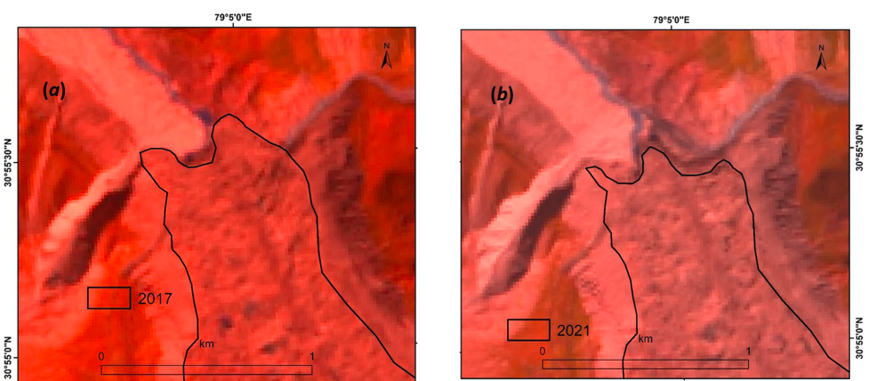
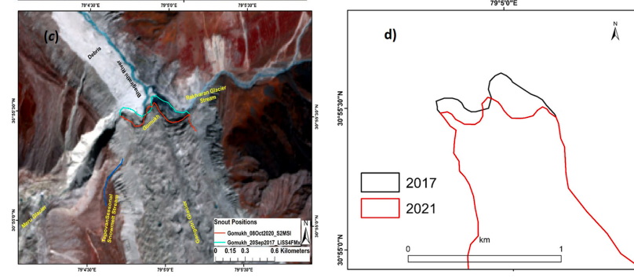
Results 1 - Thakur K.P et. al
Surface Velocity Changes of Gangotri Glacier:
2013-2014 (Sentinel-2 MSI Data)
Glacier velocity (0-150 m): ~8 m/year, (150 m - 3 km) ~18.32 m/year,(3 km - 6 km)~27.56 m/year
2013-2014 (Landsat OLI Data)
Mean glacier velocity: ~7.17 m/year (higher range)
2015
Glacier velocity (214 m): ~24.52 m/year (3.18 km - 6.36 km): ~32.89 m/year
2018-2019 (Sentinel-2 MSI Data)
Mean glacier velocity (0-150 m): ~8 m/year
Snout Retreat
Fig 10: Relative positions of Gomukh snout during 2017 and 2021 time period.
Thakur, P,K., Pandey & Chauhan, P (2023)

Slide 18
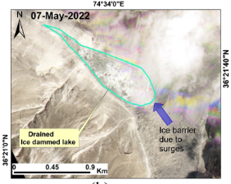
Result 2 - Singh H., et al.
Evolution of Shisper ice-dammed lake: The Shisper lake bifurcated which led to one part blocking water flow in Mochowar glacier and other part continued to flow downstream.
Glacier velocity:
Ablation zone: Melt velocity 12.02 m/year and maximum velocity 111.42 m/year.
Accumulation zone: Melt velocity 1.91 m/year and maximum velocity 62.88 m/year
Ice thickness and lake formation at Mochowar glacier: Maximum glacier thickness 409.31 m
Fig 11: Ice dammed lake formed due to Shisper lake surge
Source: Singh H et. Al (2023)

Slide 19
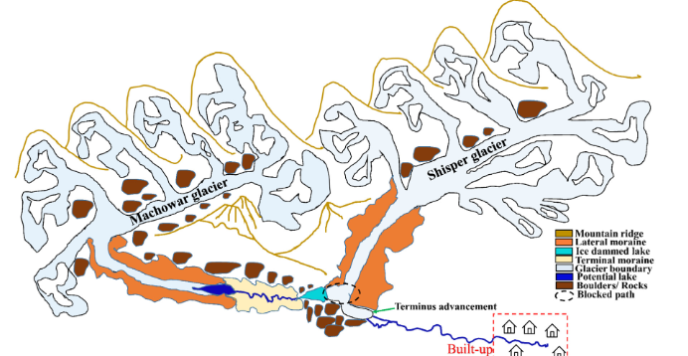
Result 2 - Singh H. et al.
Potential lake in Mochowar terminus has Length 1.2 km, Area 0.22 km2, Maximum depth 146.77 m² and Volume 3.9 MCM.
GLOF simulation for Shisper lake: Modelled for May 2022 at 7:00 am Peak flow 1505 m3/s. Flood travelled 8.7 km in 28 min.
Investigation of stream morphological changes: For May 2022 GLOF event, there was 4 times increased in surface area and stream width (15.43 m to 62.08 m) .
GLOF Susceptibility Potential Mochowar lake 0.76
GLOF Susceptibility Shisper ice dammed lake 0.94.
Fig 12: Present and future scenario of Shisper and Mochowar glacial system
Source: Singh H et. Al (2023)

Slide 20
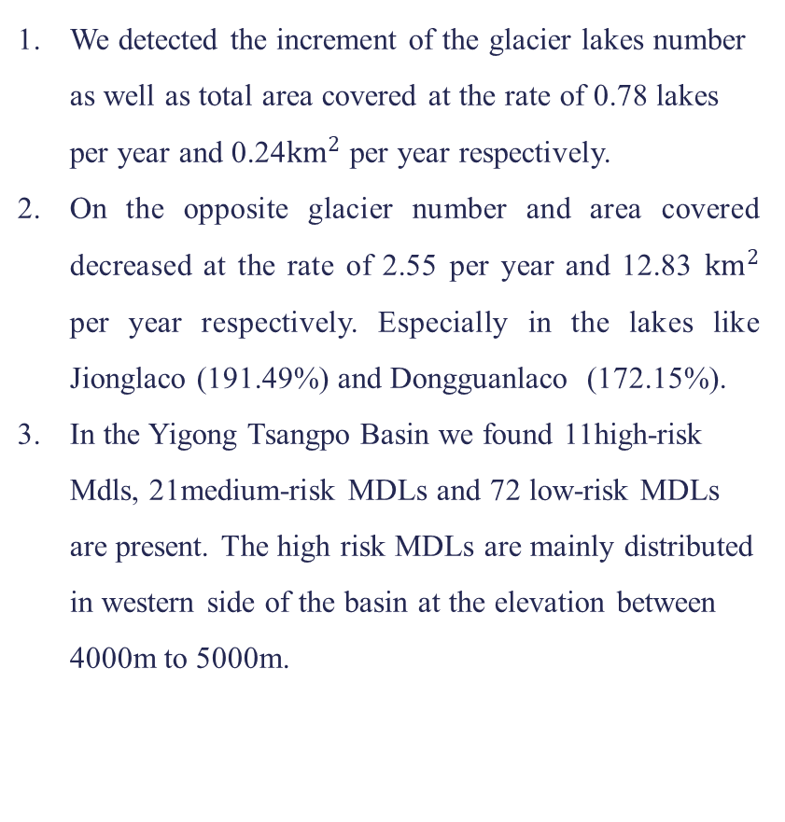
Results 3 - Ziyang et al.
Verify the feasibility of the model
Plotted the ROC curve
Outburst susceptibility assessment model
P(Y=1)=$\{1+exp⁡[−(−12.424+4.88X_{1}+3.17X_{2}+0.109X_{3}+0.196X_{4}+0.141X_{5}−3.294X_{6})]\}^{−1}$
Outburst susceptibility assessment model
P(Y=1)= {1+exp⁡[−(−12.424+4.88𝑋_1+3.17𝑋_2+0.109𝑋_3+0.196𝑋_4+0.141𝑋_5−3.294𝑋_6)]}^(−1)
The results of the outburst susceptibility of MDLs
We detected the increment of the glacier lakes number as well as total area covered at the rate of 0.78 lakes per year and 0.24${km}^{2}$ per year respectively.
On the opposite glacier number and area covered decreased at the rate of 2.55 per year and 12.83 ${km}^{2}$ per year respectively. Especially in the lakes like Jionglaco (191.49%) and Dongguanlaco (172.15%).
In the Yigong Tsangpo Basin we found 11high-risk Mdls, 21medium-risk MDLs and 72 low-risk MDLs are present. The high risk MDLs are mainly distributed in western side of the basin at the elevation between 4000m to 5000m.

Slide 21
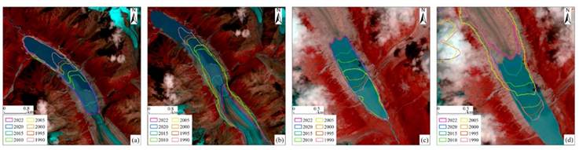
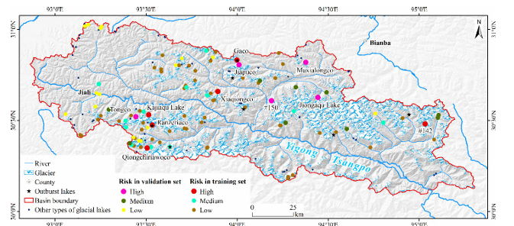
Results 3 - Ziyang et al.
Fig. 13: Change process of typical glacial lakes and the tongues of their parent glaciers. (a) Jionglaco; (b) tongue of the Jionglaco parent glacier; (c) Dongguanlaco; (d) tongue of the Dongguanlaco parent glacier, Ziyang et al. 2024
Fig 14: Risk levels of MDLs in the Yigong Tsangpo Basin, Ziyang et al. 2024

Slide 22
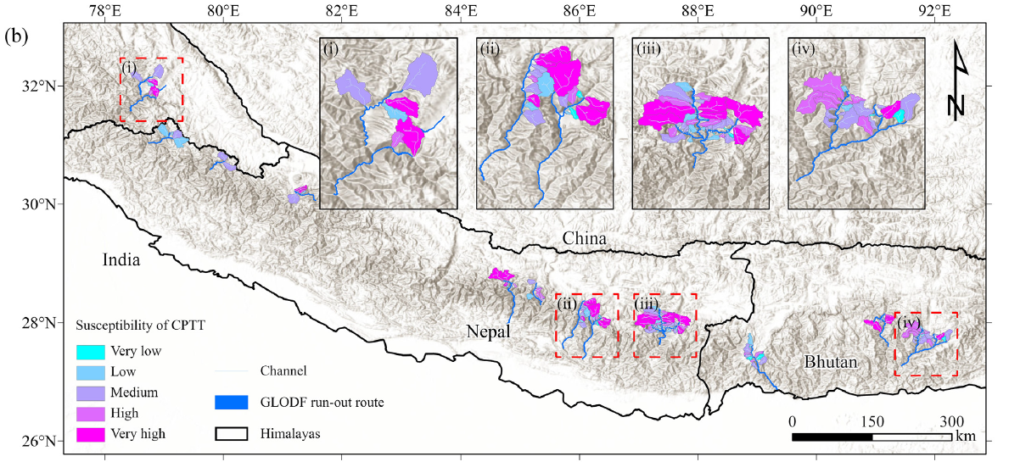
Results 4 - ZHOU B. et al.
Key Findings from GLODF Susceptibility Analysis
Best Performing Model:
WOA-SVC achieved the highest prediction accuracy, outperforming RF and GTB.
High-Risk GLODF Zones Identified:
High & Very High Susceptibility Areas are concentrated in the Eastern & Central Himalayas.
China-Nepal Border is the most critical transboundary hotspot for GLODF threats.
128 Catchments Identified with Potential Transboundary Threat (CPTT) – with 23 Very High Susceptible and 29 High Susceptible.
34 % of the Overall region is identified as the Susceptible (Very High and High)
Fig 15: Susceptibility of catchments with the potential
transboundary threat in the Himalayas
Source: ZHOU B. et al. / Advances in Climate Change Research 15 (2024) 500e514

Slide 23
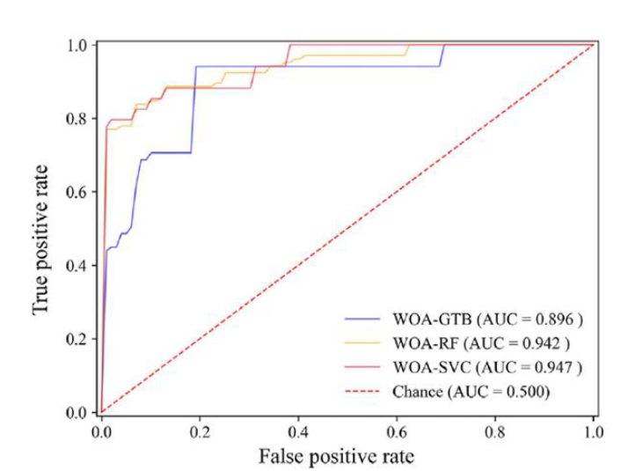
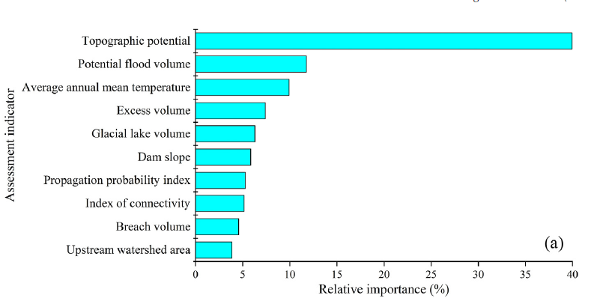
Results 4 - ZHOU B. et al.
Factor | Impact on GLODF | Influence percentage (%)
Topographic Potential | Steeper slopes mean higher risk. More critical factor. | 39.96
Potential Flood Volume | Bigger lakes mean more damage | 11.76
Annual mean Temperature | Increase in Global warming meltwater and making GLODF’s more common. | ~ 10
Excess Volume | Loose rocks in the flood path make the flow worse. | 7.39
Glacier lake volume | Change in the volume leads, increase in the flow rate. | 6.30
Propagation probability index | How fat the debris will travel | 5.28
Connectivity Index | How easily the debris flows | 5.14
Fig 16: ROC curve of three models
Model Validation & Accuracy Metrics:
AUC Scores: WOA-SVC > RF > GTB
High reliability confirmed by ROC-AUC analysis
Fig 17: Relative importance and distribution of assessment indicators

Slide 24
Conclusion
The assessment confirms an increasing susceptibility to glacier outbursts in the Himalayan region.
High-risk levels indicate a strong possibility of future glacier floods affecting downstream villages.
These findings highlight the urgent need for proactive risk mitigation strategies.
Authorities must implement appropriate measures to reduce potential hazards and protect vulnerable communities.
Continued monitoring and adaptation strategies are essential for long-term resilience against glacier-related disasters.
Practical Implications: ✔ Early warning systems for Disaster management ✔ Guides policymakers in transboundary hazard mitigation

Slide 25
References
Singh, H., Varade, Van Wyk de Vries, & etal, Assessment of potential present and future glacial lake outburst flood hazard in the Hunza valley: A case study of Shisper and Mochowar glacier, Science of total environment, 868, 161717.
Thakur, P,K., Pandey & Chauhan, P (2023), Assessment of dynamics frontal of part of Gangotri glacier, India, from 2017 to 2021 using remote sensing data, Journal of Indian society of Remote Sensing, 51(4), 691-698.
Yuan Z, Wang R, & etal, (2024) Expanding glacial lakes and assessing outburst susceptibility of moraine-dammed lakes using logistics regression in the Yigong Tsangpo basin Tibet, China, Natural hazards.
Zhou B, Zou Q & etal, (2024), Process-driven susceptibility assessment of glacial lake outburst debris flow in the Himalayas under climate change, Advances in climate change research 15, 500-514.

